Slide 1
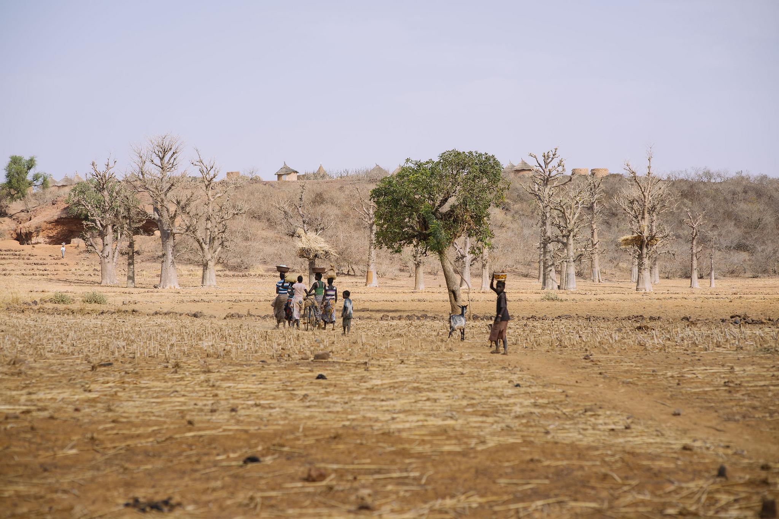
Beyond climate change dichotomy: gender forest and trees in climate change adaptation in Mali and Burkina Faso
Houria Djoudi, Nadia Djenontin, Christoffe Koffi Koame , Denis GautierMathurin Zida, Djibril Dayamba, Maria Brockhaus and Bruno Locatelli.

Slide 2

Dichotomy
Vulnerable versus agent of changes
Women versus men
Adaptation versus Mitigation

Slide 3
Diversification strategies by women in the pastoral community
Migration
Education (children schooling)
Trade
Mobile and sedentary livestock
Handicraft
Forest
Livestock
Handicraft
Forest
Trade
Women
Men

Slide 4
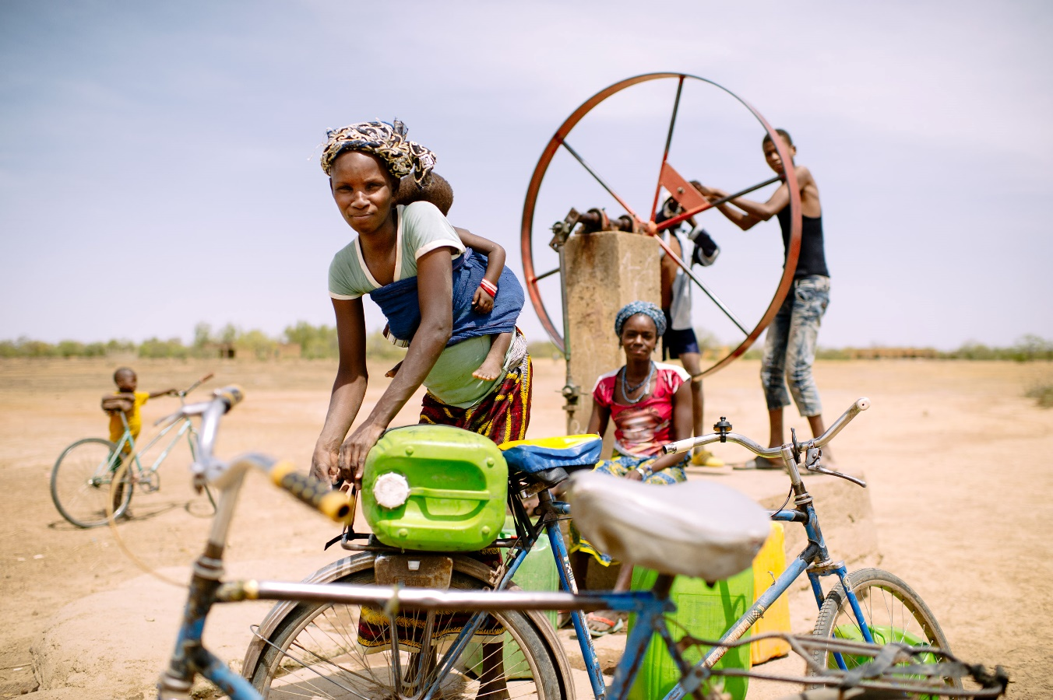
Women are adapting to different impacts than men
Double burden CC and men strategies
Women’s long term strategies

Slide 5
Forest Land Restoration crucial for Food security during food shortages
Women
Men

Slide 6
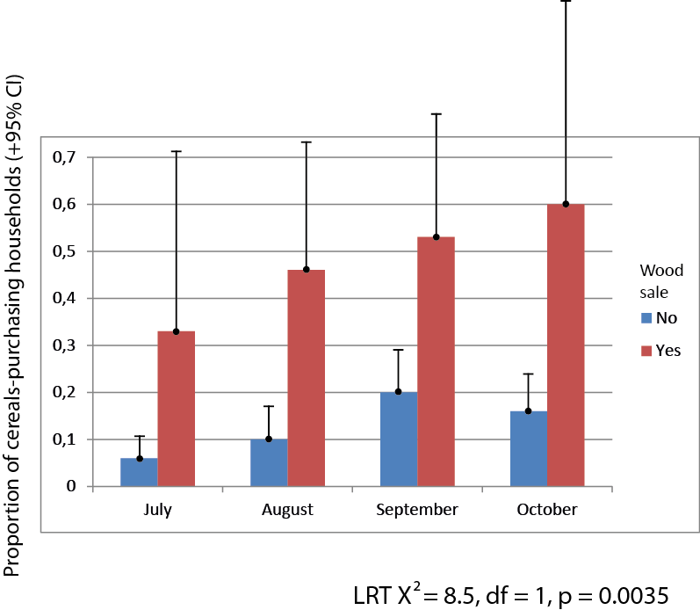
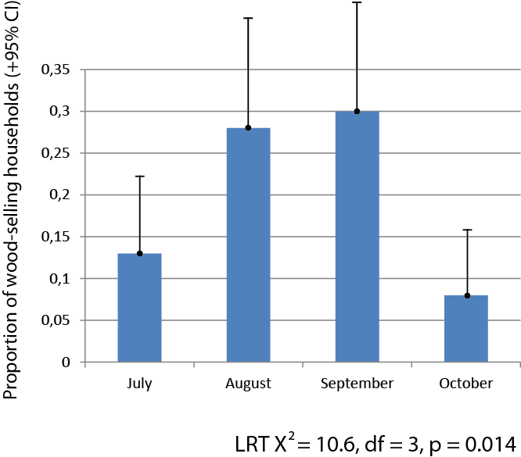
Forest areas : More cereal purchase by wood sellers
A household selling wood is about 4 times more likely to buy cereals
Notes:
Second result: there is a significant main effect of wood sale on cereals purchase in Sorobouly
There is about 4 times households likely to have bought cereals when having sold wood

Slide 7
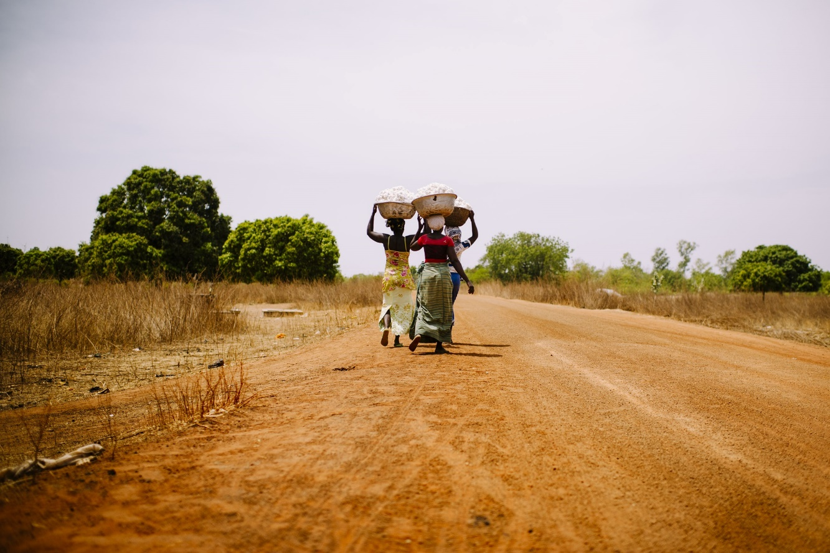
Intersectionality
Women have different access to ressources according to their ethnical affiliation and class.
Adaptation strategies are hindered or enhanced by social affiliation

Slide 8
Gender co-benefits or trade-offs
Index Value
Plantations
Restored areas.
Landuse Class

Slide 9
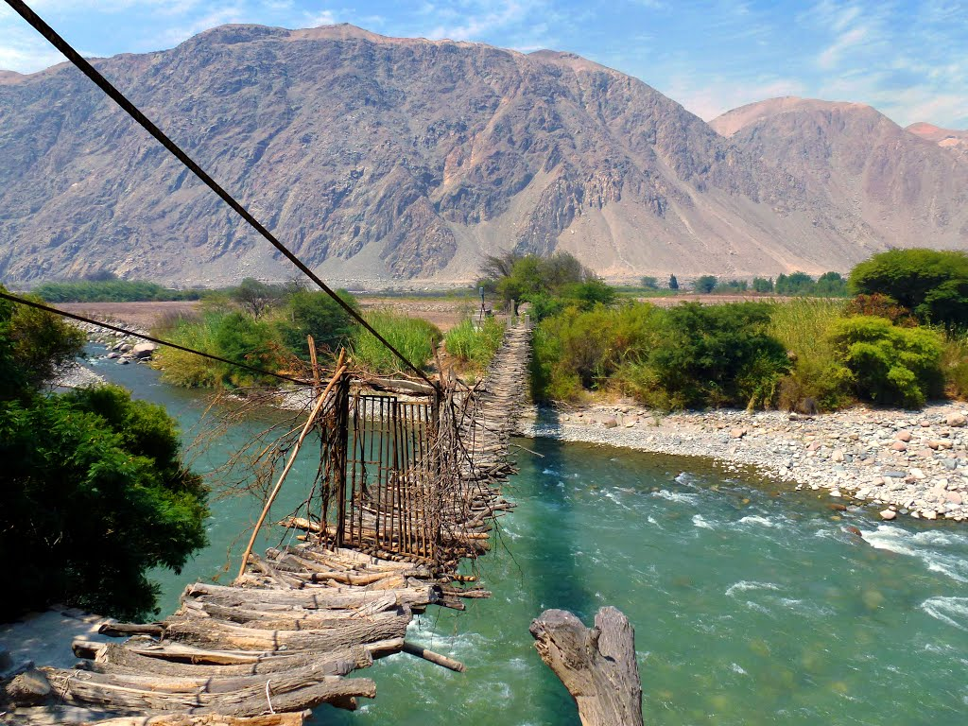
Lessons learned
Intersectionality to overcome simplifications
Gender specific vulnerability analysis
Linking adaptation and mitigation actions to overcome gender negative outcomes
Photo: Bruno Locatelli

